Slide 1

The World Food Security Crisis and
Coming Agrifood Systems Transformations
Christopher B. Barrett
Cornell University
Presentation to the
2022 Autumn Meeting of the SONAE Global Advisory Board
November 14, 2022

Slide 2
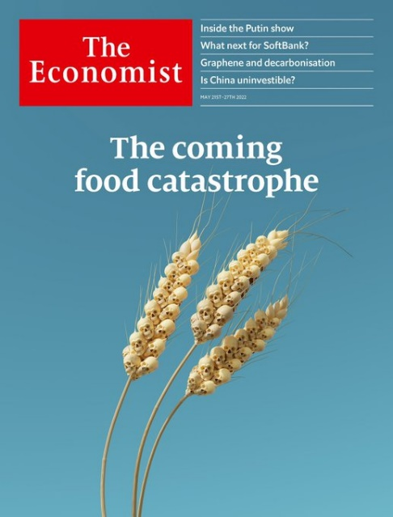
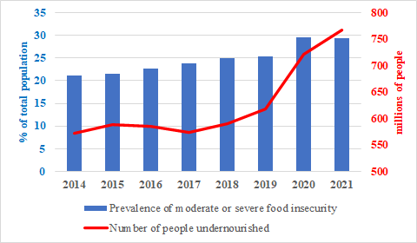
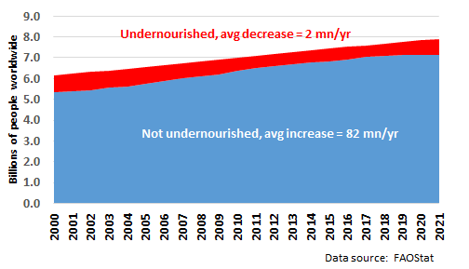
Is there a food security crisis?
“The World Is Headed for a Food Security Crisis”
– Time, Mar 2018
“A Global Food Crisis Looms” – New York Times, Apr 2020
Is there a food security crisis currently?
Yes …
… but crisis = stalled progress

Slide 3
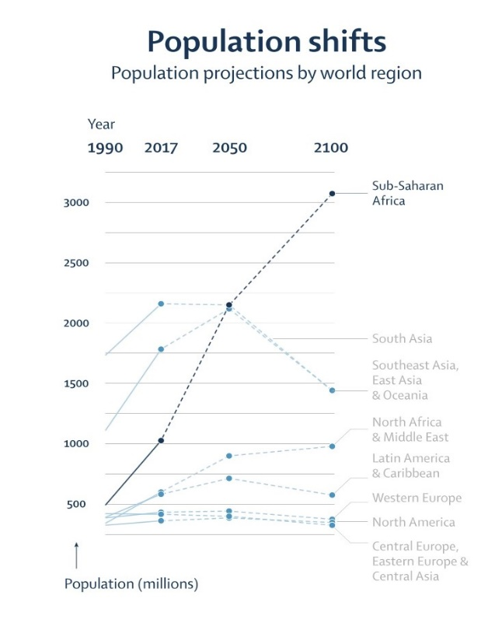
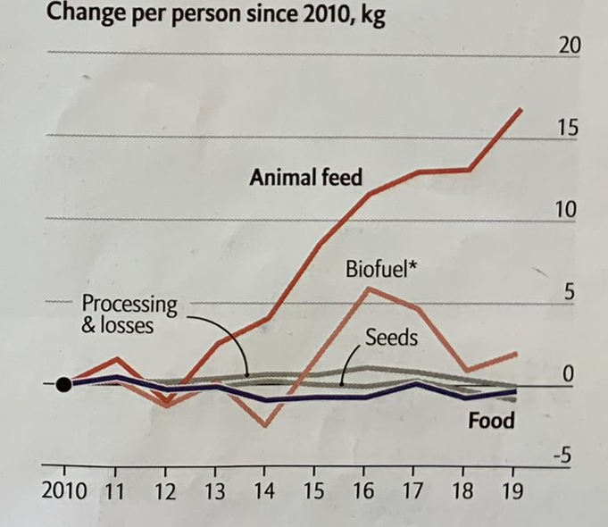
Why stalled progress?
Demand growth outpacing supply growth.
Pattern will continue w/o AFS transformation.
Long-run drivers:
1. Population/income growth, urbanization
robust food demand growth,
almost entirely in Asia and Africa.
Can only slow/shift a bit via policies:
tax/subsidies, public procurement.
Even less via behavioral nudges.
Vollset et al. Lancet 2020
Source: The Economist June 25, 2022

Slide 4
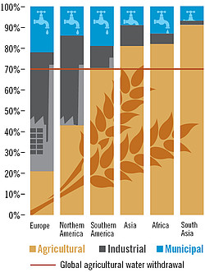
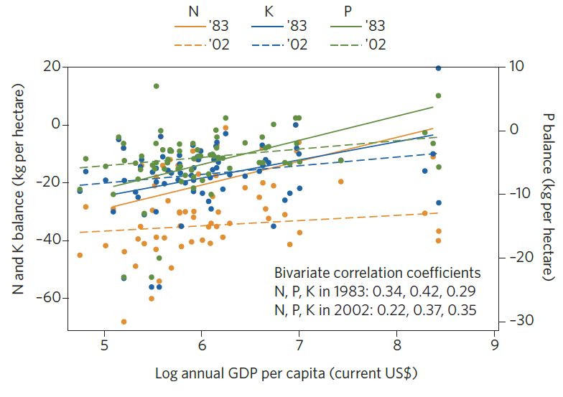
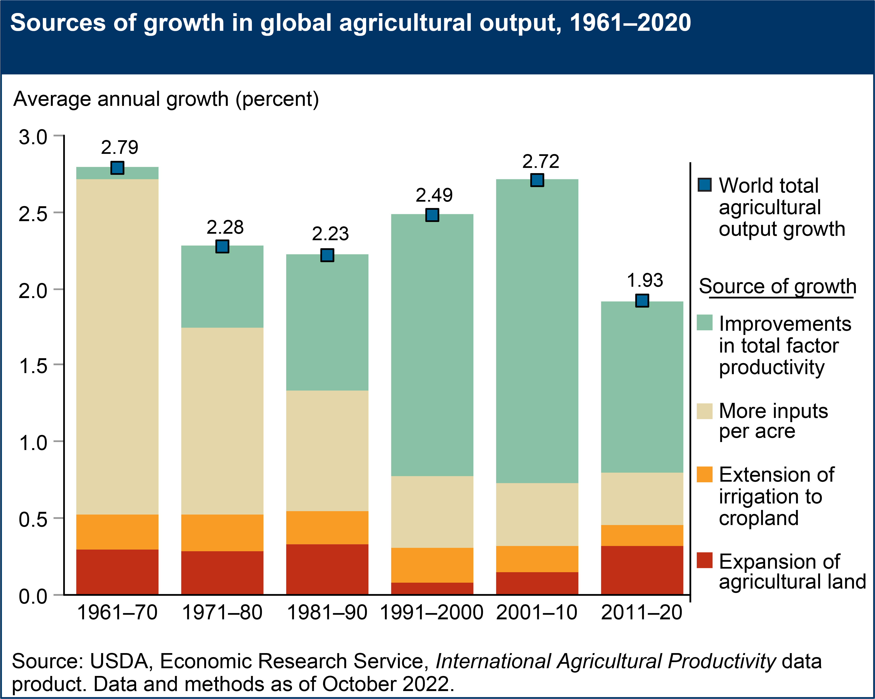
Why stalled progress?
2. Land/water constraints + climate change + slowing productivity growth
strong headwinds for supply growth
Ag soils N, P and K fluxes in sub-Saharan Africa, 1983-2002
Source: Barrett and Bevis Nature Geoscience 2015
Source: https://www.globalagriculture.org/report-topics/water.html

Slide 5
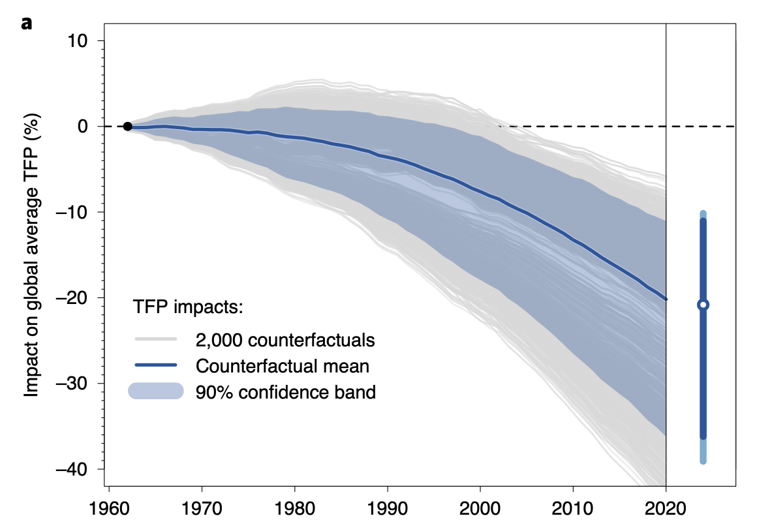
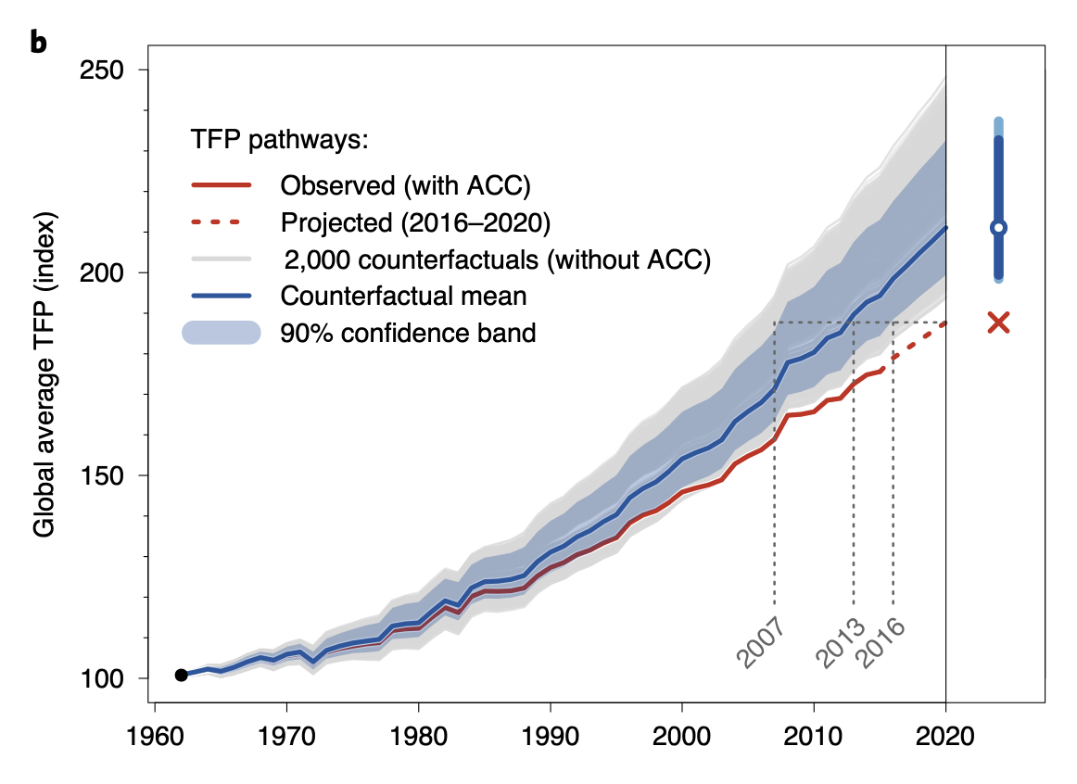
Why crisis?
Insufficient investment in boosting food supplies sustainably has left the world vulnerable to ‘perfect storms’, which occur more often.
1. Climate change:
Fuel demand growth by forced displacement – climate refugees, droughts, etc.
Retards productivity advances and investment
Source: Ortiz-Bobea et al (Nature Climate Change, 2021)

Slide 6
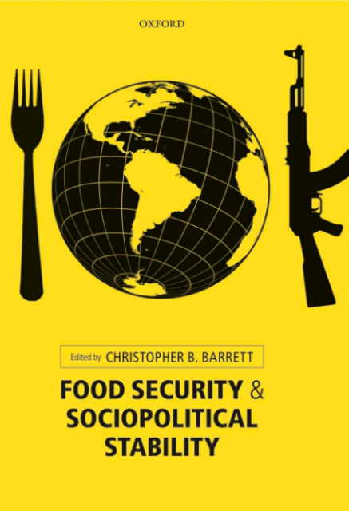
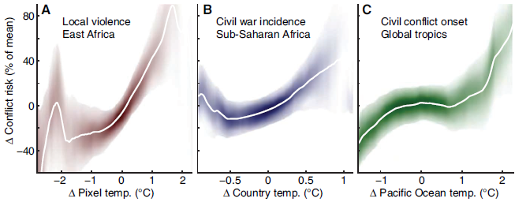
Why crisis?
2. Conflict:
>89mn forcibly displaced +~15mn Ukraine this year… highest on record
Conflict-affected nations >75% of stunted children globally (FAO et al. 2017)
Pop. in fragile settings growing. >2bn now, ~ 80% world’s poor (OECD 2018)
Food insecurity destabilizes societies lacking strong social
safety nets. Unrest in ~50 nations 2007-12. Sri Lanka now.
And climate change makes it worse …
(Hsiang et al. 2013)

Slide 7
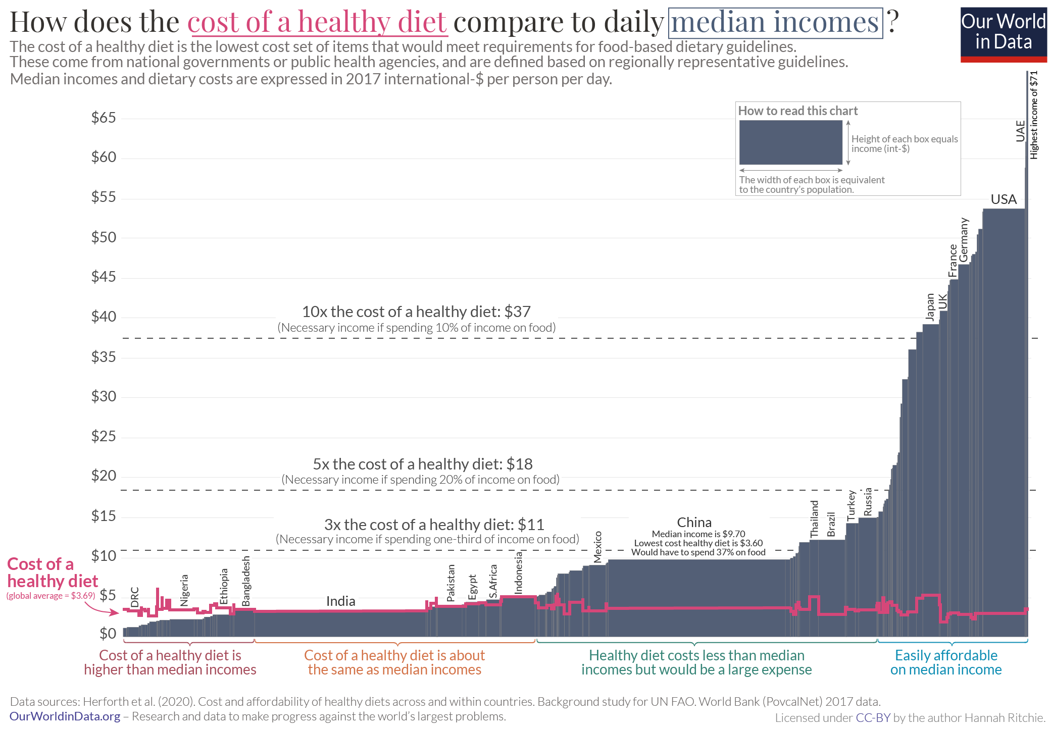
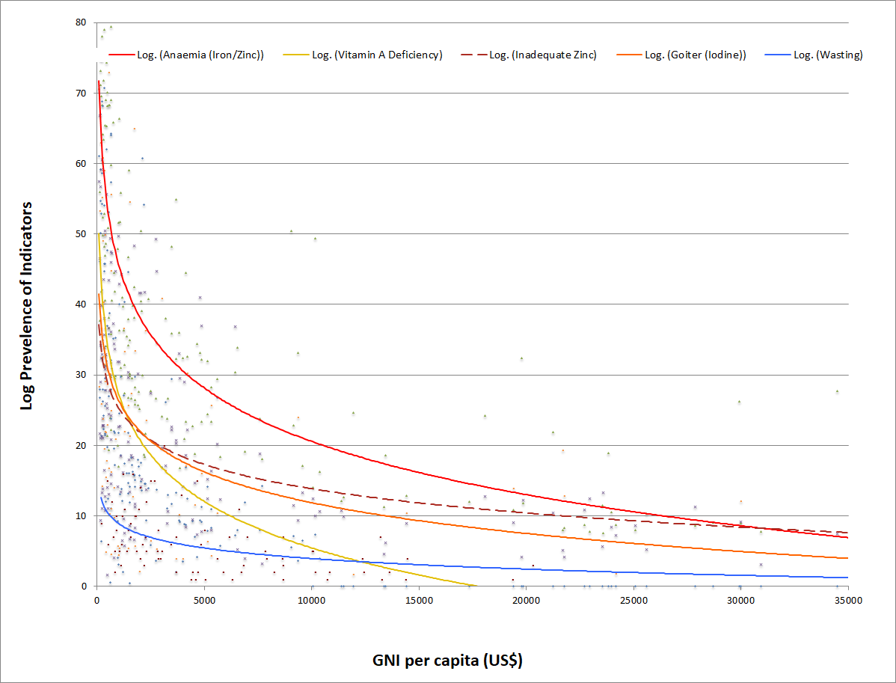
Why crisis?
3. Macroeconomic growth and stability
Poverty is main cause of food insecurity. Growth reduces poverty. COVID slowed growth. Macro instability fuels flight to dollar, debt/food prices worsen in LMIC.
>3 bn cannot afford a healthy diet. Social protection schemes insufficient.
Source: Barrett and Bevis, 2015
Source: Barrett and Bevis, 2015

Slide 8
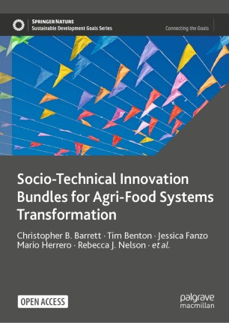
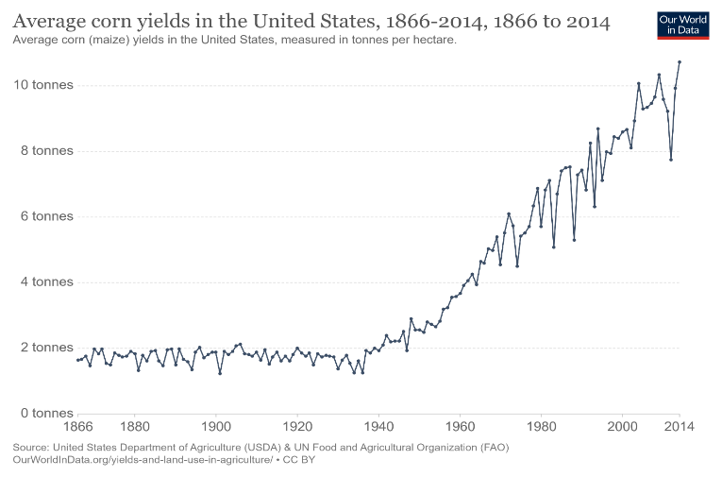
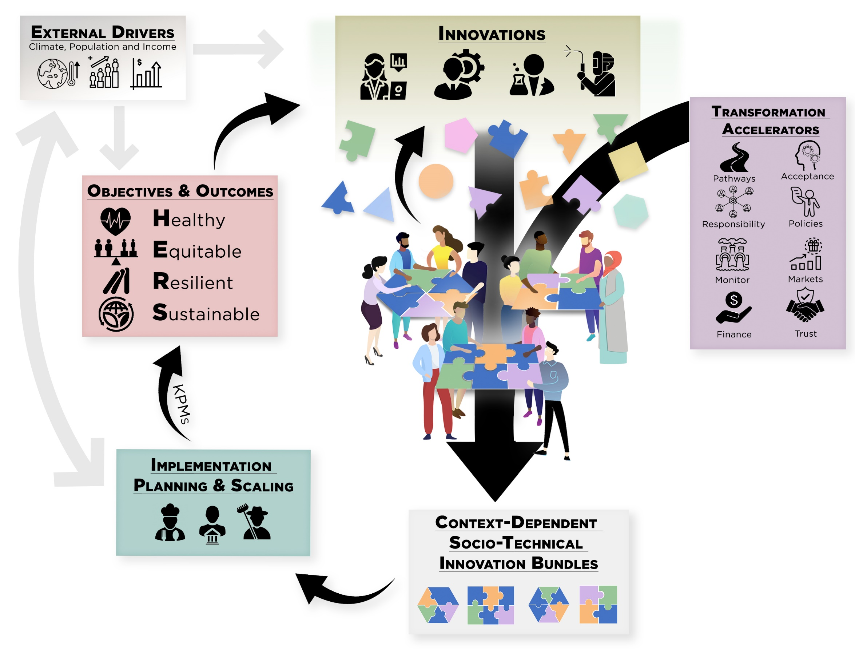
Don’t despair … act!
The world has previously and can again overcome global food crises.
We can prevail again IFF we follow a progressive strategy:
trust in science + demonstrate solidarity w/poor … must bundle the two.
Must define the task(s) correctly. It’s no longer hunger and yields.

Slide 9
Accelerate AFS transformation
Address obstacles impeding accelerated AFS transformation.
Massively underinvested in AFS R&D. B/C 10-45. US S&P500 cash on hand >$2.7tr in Jan 2022. Annual cost of eliminating global hunger ~$25-30bn.
35% of >$52bn in 2021 agrifood tech VC funding was e-grocery! Make solving societal problems financially attractive: advance market commitments, benevolent patent extensions, etc. Learn lessons of COVID vaccines.

Slide 10
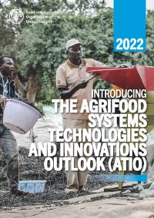
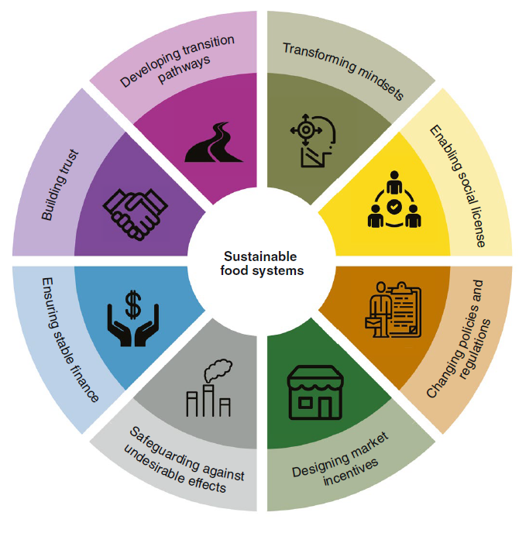
Accelerate AFS transformation
Shorten lag from AFS R&D € to impact at scale (presently 10-20 yrs)
Policy/regulatory obstacles: IP thickets, anti-science movements, protectionist labeling laws, etc. Cautionary tale of Golden Rice vs. IR8/64.
Address increasing systemic risk exposure: ex: IBLI
Level informational playing fields for LMICs through open source sharing of precompetitive data to crowd in public/philanthropic investments.
Need more R&D, but R&D without
policy/social change underdelivers
(Herrero et al. Nature Food 2020)

Slide 11

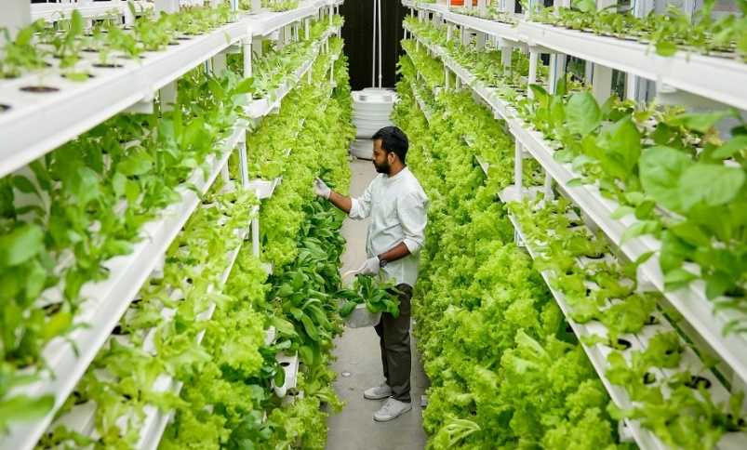
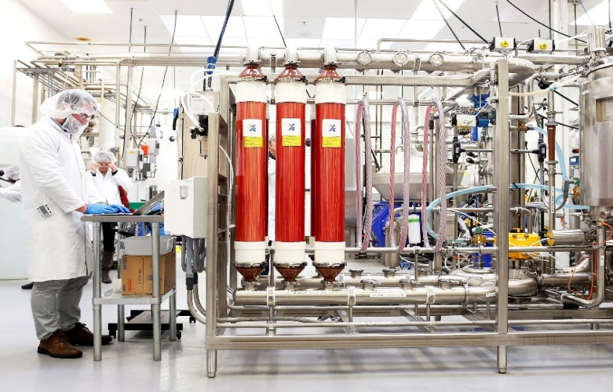
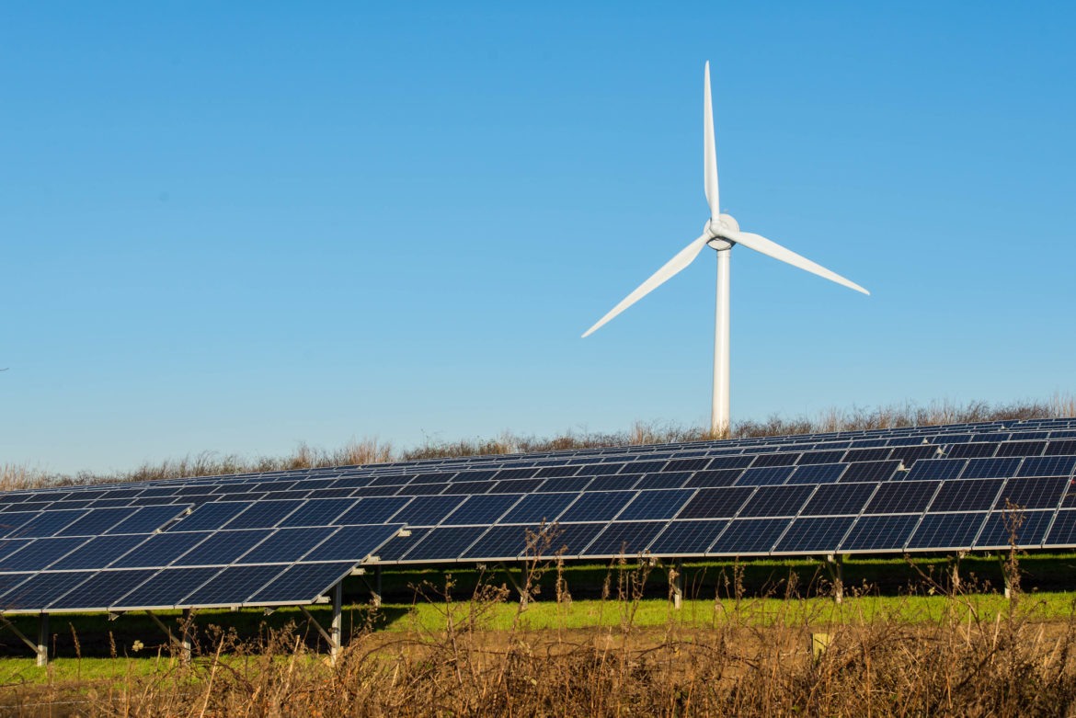
Proactive de-agrarianization
Decouple food production from land is increasingly culturally, economically, technologically feasible. Crucial for climate and infectious disease control.
Photo: Wallace Woon (Straits Times)
Photo: Betterindia.com
Photo: Beck Deifenbach/Reuters
Must manage de-agrarianization’s
creative destruction proactively. Build
new rural livelihood opportunities.
Photo: Gerry Machen/Creative Commons

Slide 12
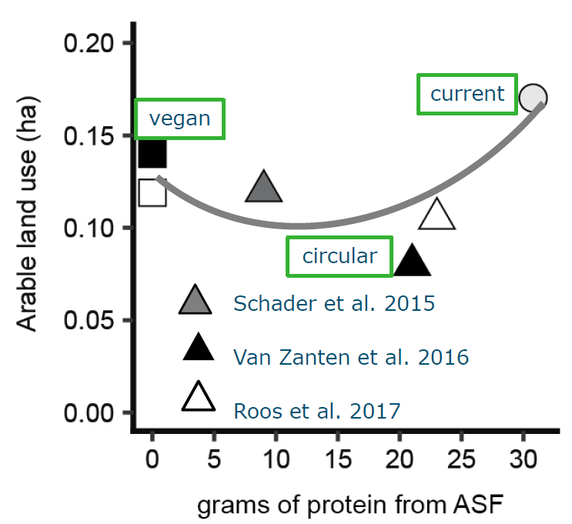
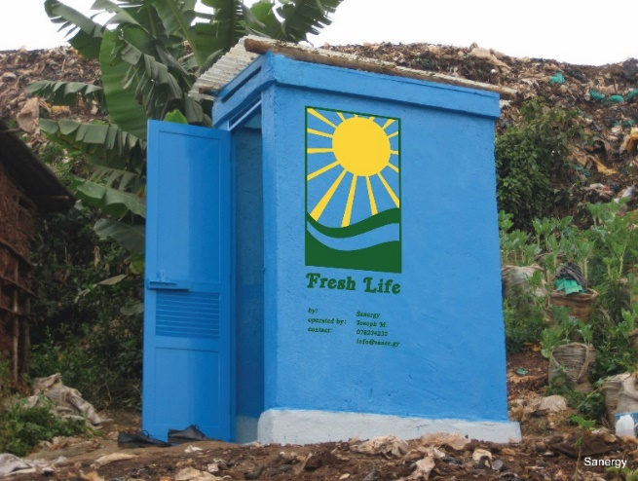
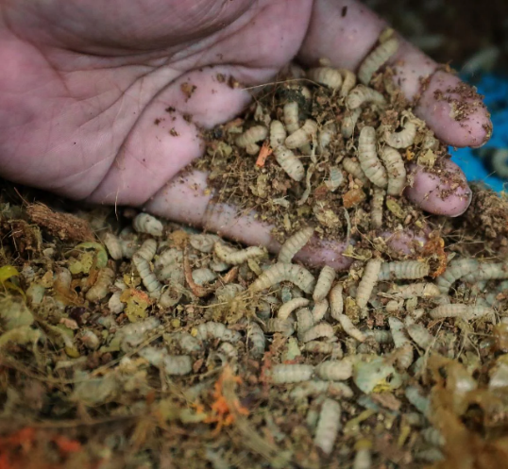
Circularity
Need cheap food for the poor. But cheap food inevitably induces loss and waste.
Recapture the nutrients as feed and fertilizer to help deagrarianize!
Credits: Sanergy; Andrew Simons et al.; Jason Quah, Straits Times; H. Van Zanten
Can maintain 2/3 ASF consumption w/o food-feed competition.
Reduce cost and geopolitical/mkt vulnerability to NPK supply disruption.

Slide 13
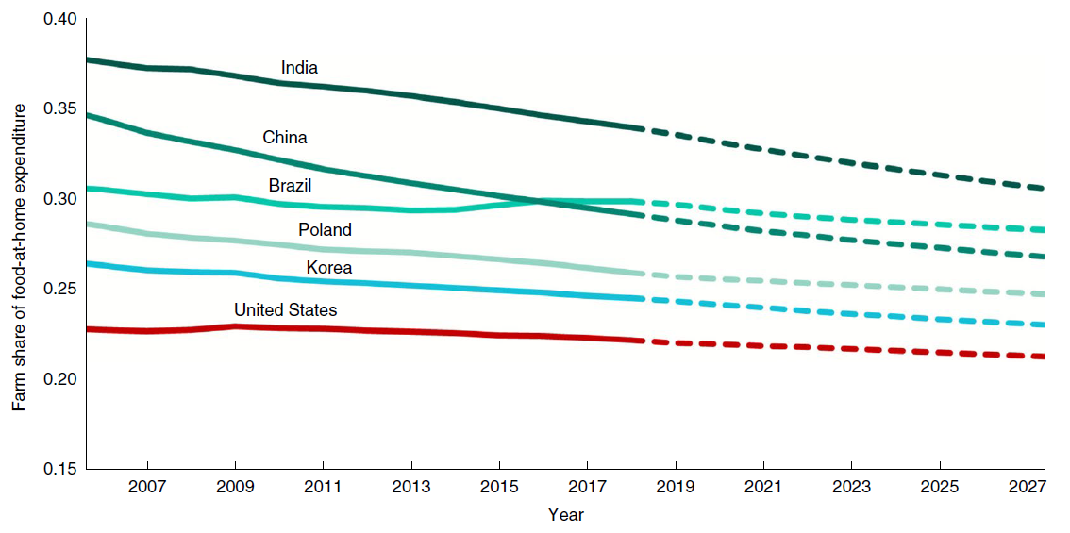
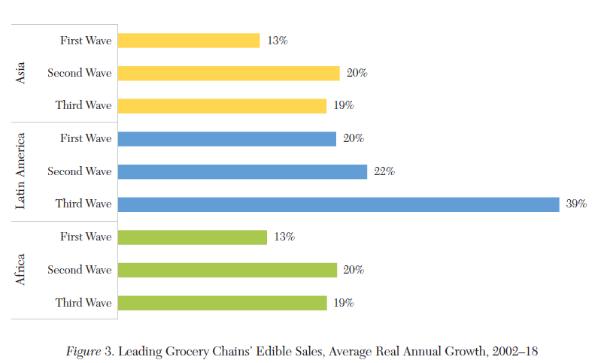
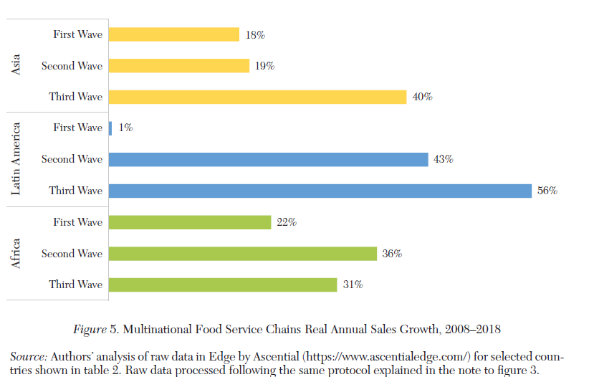
Downstream opportunities
Most AFS jobs, ultra-processing/fortification, and value creation (~3/4 globally!) occur post-farmgate and that share grows with incomes and ag TFP growth.
Big environmental impacts, too. Businesses drive AFS!
LMIC grocery stores LMIC MNC food service
Source: Yi et al., Nature Food 2021
Source: Barrett et al., J. Econ.Lit. 2022

Slide 14
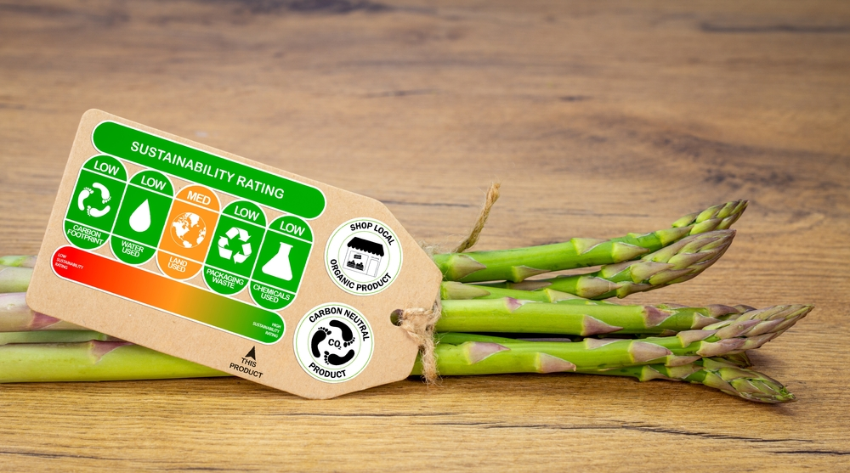
Downstream opportunities
Consumer demand for non-nutritive food attributes increasingly drives upstream production patterns.
Contracting terms w/suppliers.
Trustworthy labeling back by traceability.
True cost pricing to induce ‘race to the top’.
Source: https://www.nycfoodpolicy.org/food-policy-snapshot-denmark-climate-label/

Slide 15
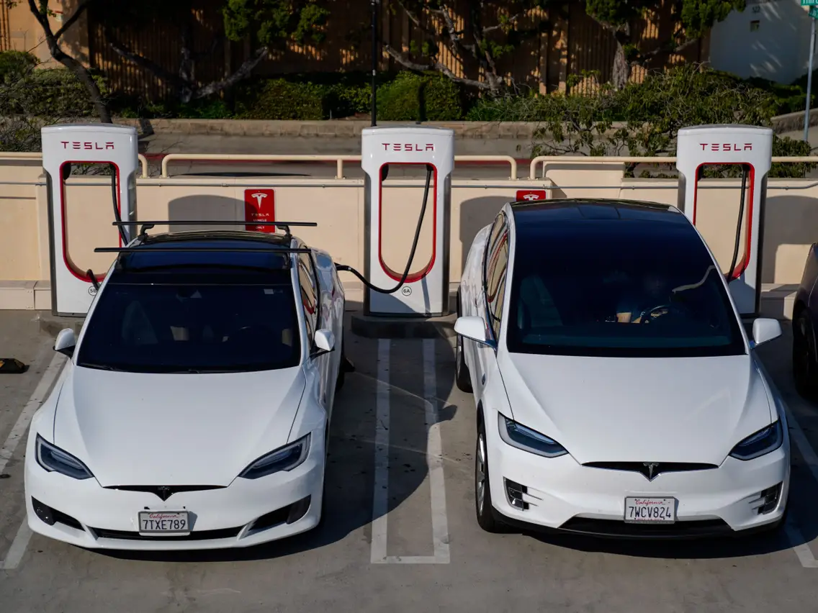

Why should we care?
Solving societal problems can be a lucrative business strategy
Human rights, sociopolitical stability, and macroeconomic growth and stability all depend on food security

Slide 16
Don’t despair, but don’t dally
The world faces another food crisis. These are growing more frequent because of insufficient attention to investing in HERS AFS transformation.
Have prevailed before in food crises and can again … will we?
Requires:
progressive strategy – trust science and support the poor
focus on HERS objectives and invest in appropriate STI. esp. de-agrarianization, circularity, and social protection
incentivize and bundling innovations esp. downstream
Thank you for your time and interest!

